Slide 1
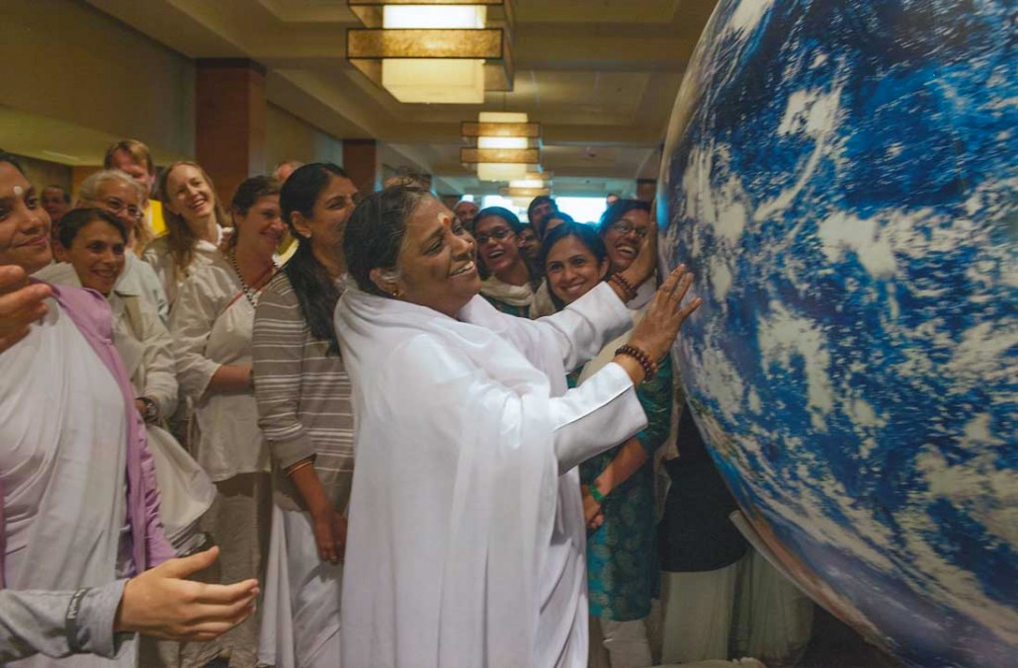
Source Reduction
Greenfriends north america

Slide 2
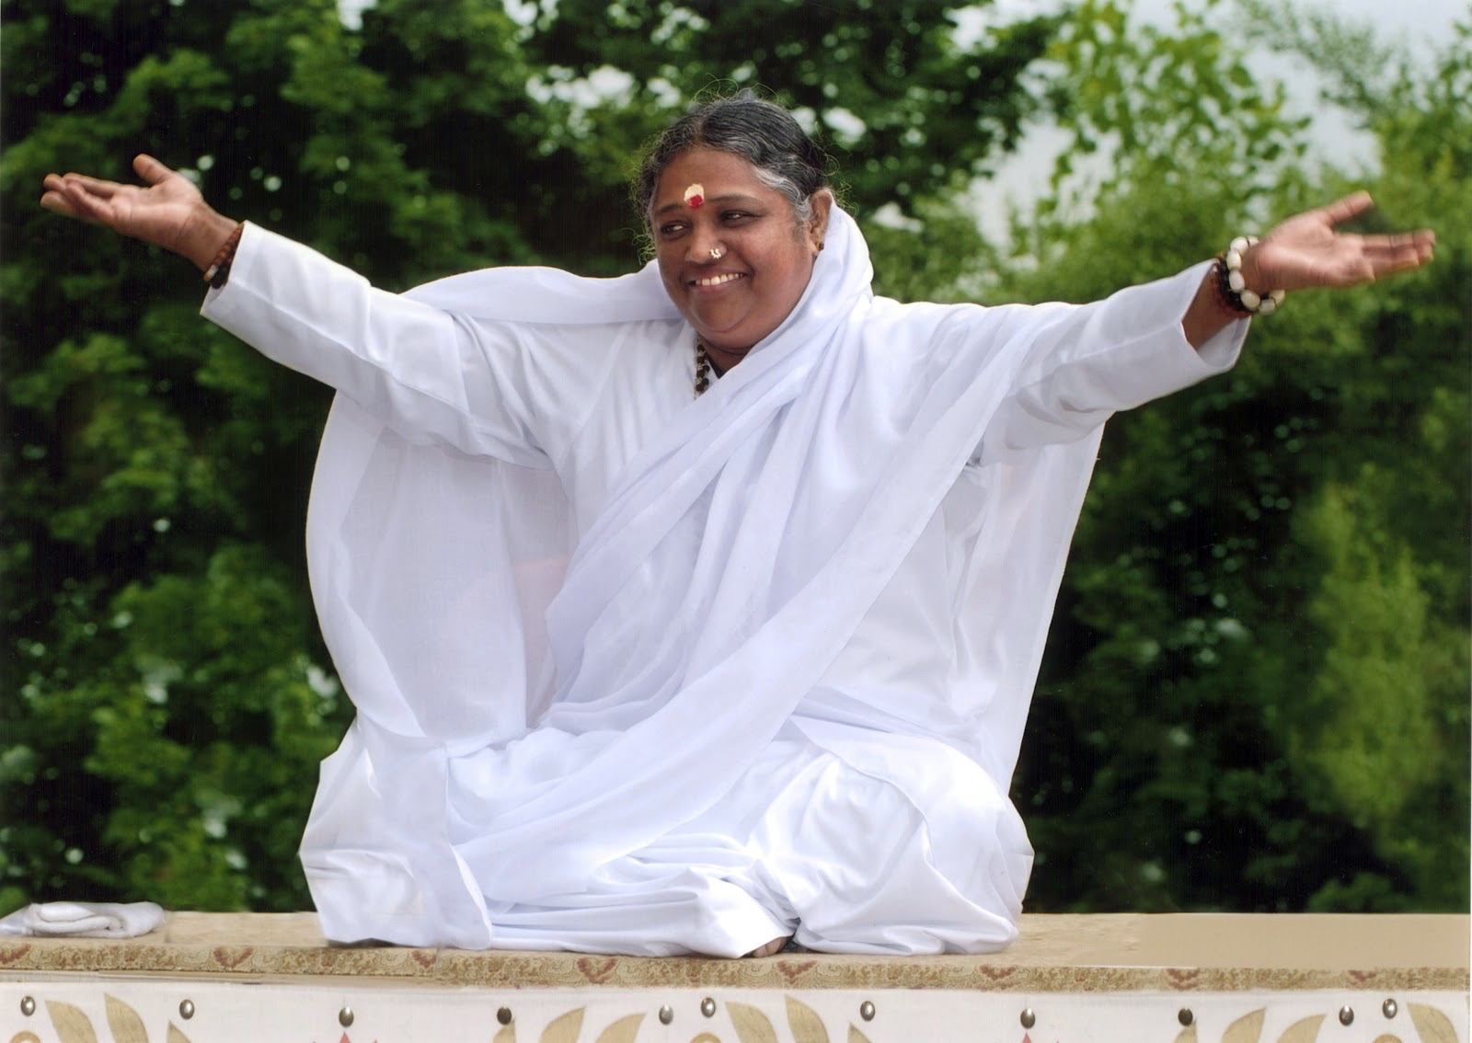
Our Beloved
Amma has asked her children to
take steps toward:
Source Reduction

Slide 3
What is Source Reduction?
Source Reduction is preventing pollution of the Earth before it actually happens.
This requires discrimination in our choices of what to use and what to buy as we live our lives.

Slide 4
Why Source Reduction?
Because Earth is our Home and we need to learn to live responsibly as a part of Nature.
Earth supports our lives. We need to care for, respect, and live sustainably on this beautiful planet that provides us with the air, water, and food that we need to live.

Slide 5
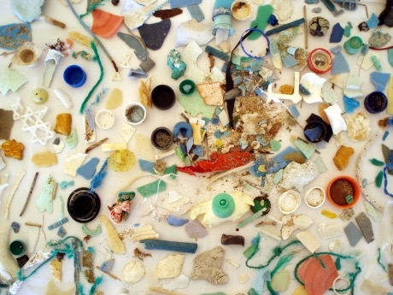
How are we currently affecting the Earth?
PLASTIC is accumulating in the oceans as:
MACROPARTICLES

Slide 6
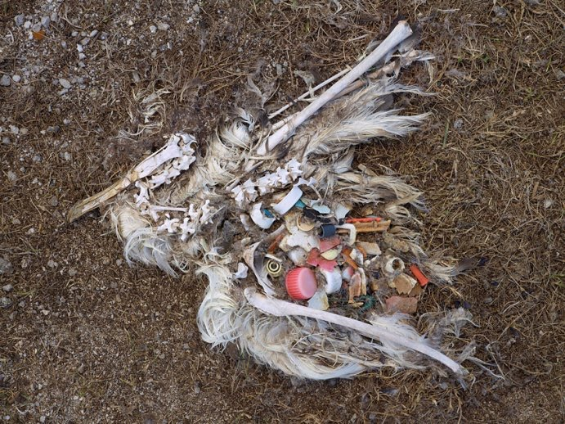
Birds and sea creatures mistake plastic objects as food.

Slide 7
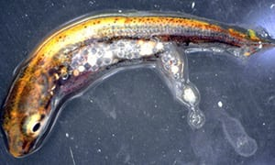
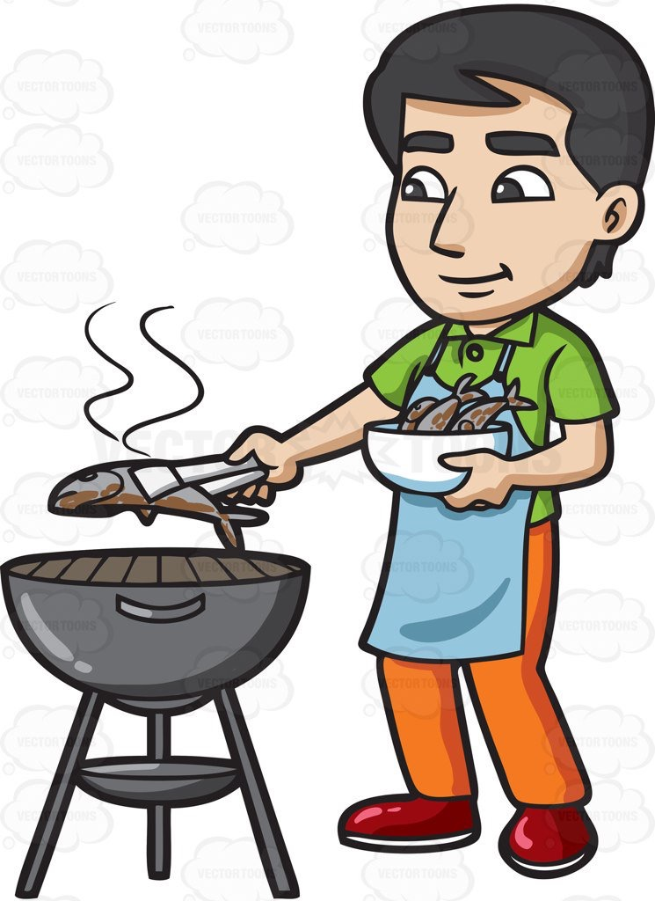
Fish and other creatures ingest toxic plastic MICROPARTICLES.
As these creatures are eaten, the poisonous chemicals get passed up the food chain, eventually showing up in our food supply.

Slide 8
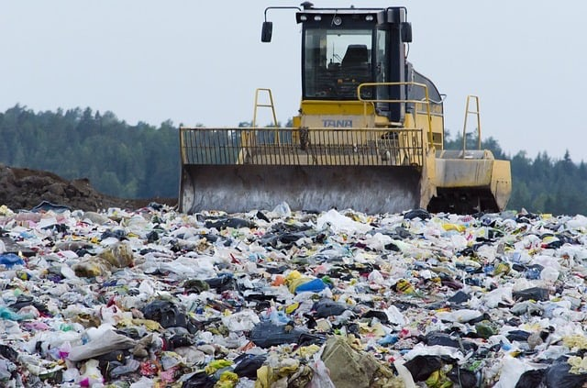
LANDFILLS are not earth-friendly!

Slide 9
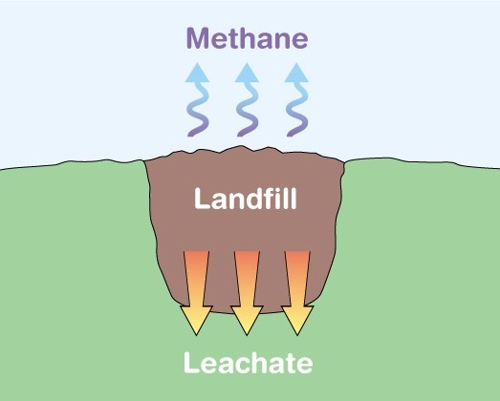
LANDFILLS cause:
Air Pollution
Water Pollution
Land Pollution

Slide 10
Even biodegradable items take a long time to decompose in a landfill

Slide 11
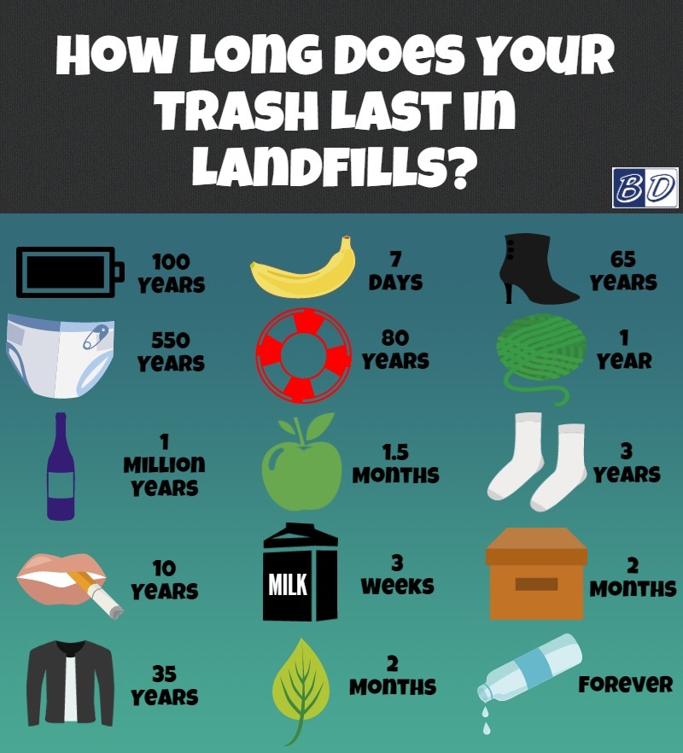

Slide 12
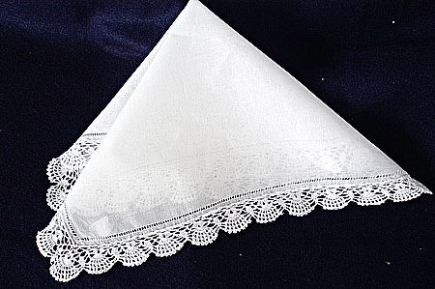
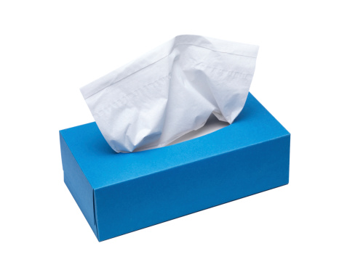
Source reduction requires us to think about our daily choices.
For example using this:
Instead of this:

Slide 13
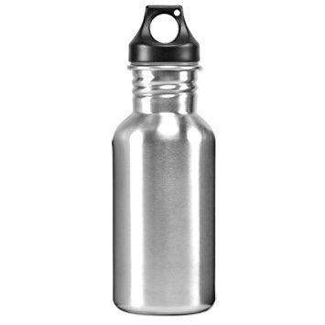
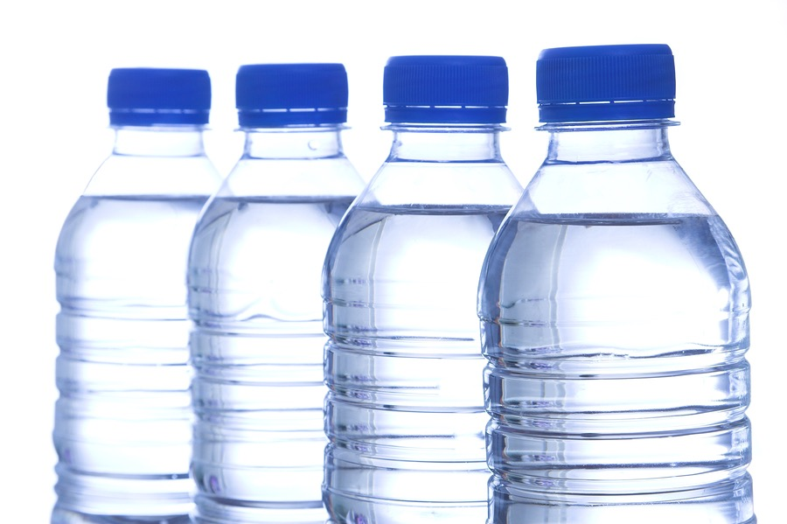
OR
This:
Instead of this:

Slide 14
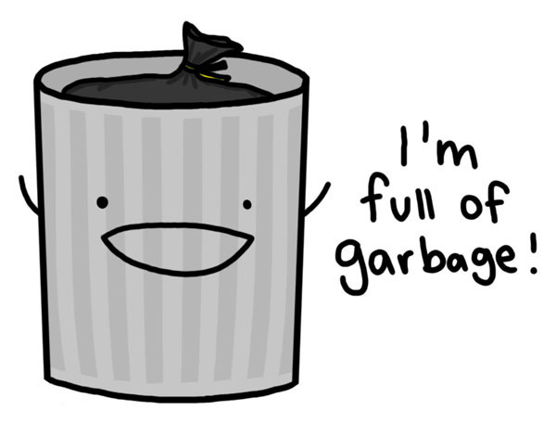
Let’s examine what we throw away:
Food
Disposable Items
Hazardous Chemicals
Used Items that are Worn Out

Slide 15
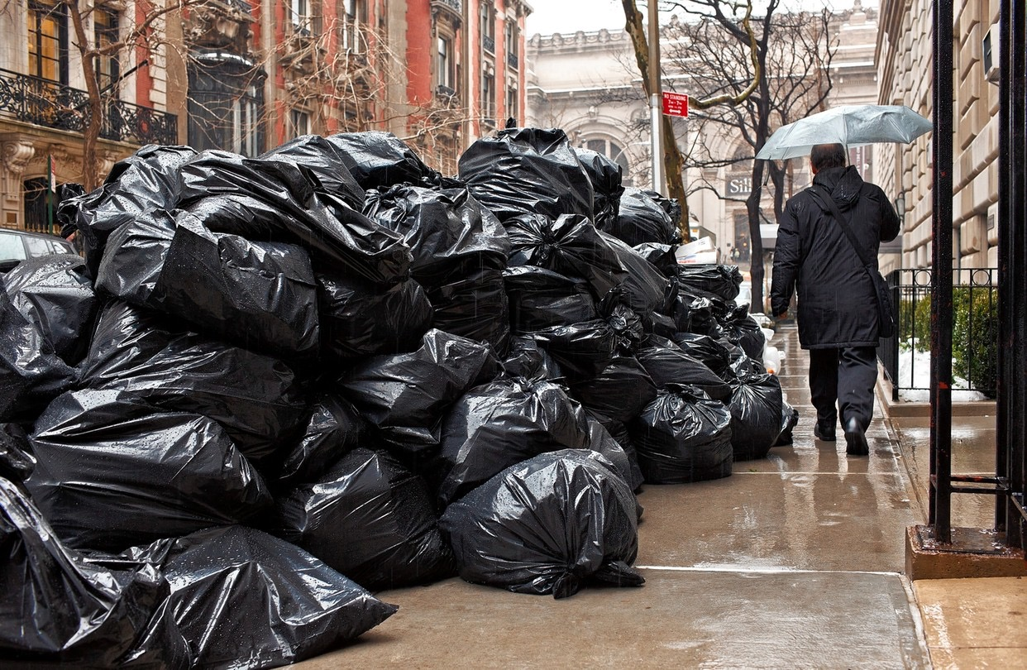
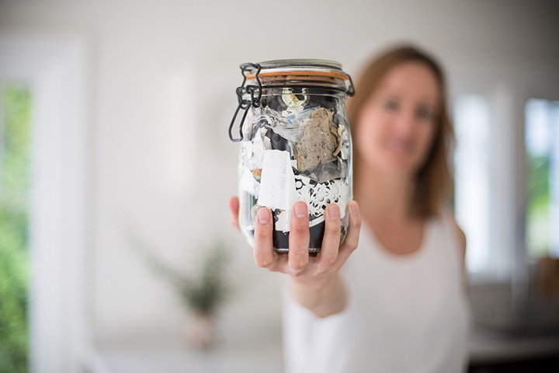
And Consider a Zero Waste Lifestyle
To go from this:
To this:

Slide 16
What can we do to honor Amma’s request?

Slide 17
Use these three practices:
Reduce
Reuse
Conserve

Slide 18
Source Reduction Practices:
Replace disposable or single-use items with reusable alternatives
Make our own products
Buy in bulk
Buy local

Slide 19
Source Reduction Practices:
Swap, trade, borrow or rent items
Conserve natural resources and reduce pollution
Avoid using hazardous chemicals
Consume less

Slide 20
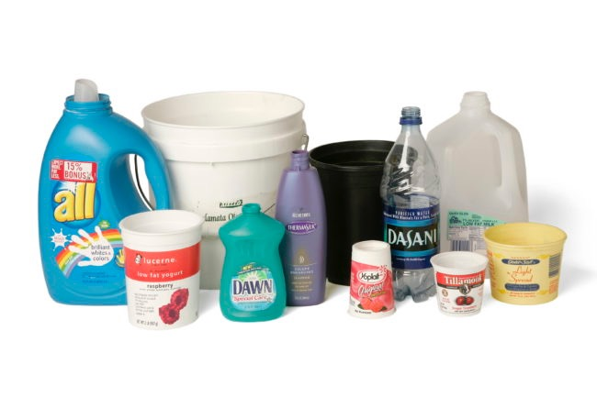
PLASTICS

Slide 21
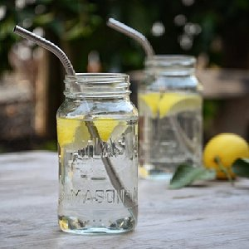
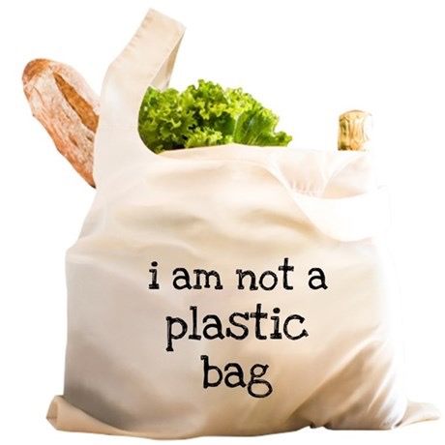
Replace Plastic:
Use stainless steel straws
Use cloth bags

Slide 22
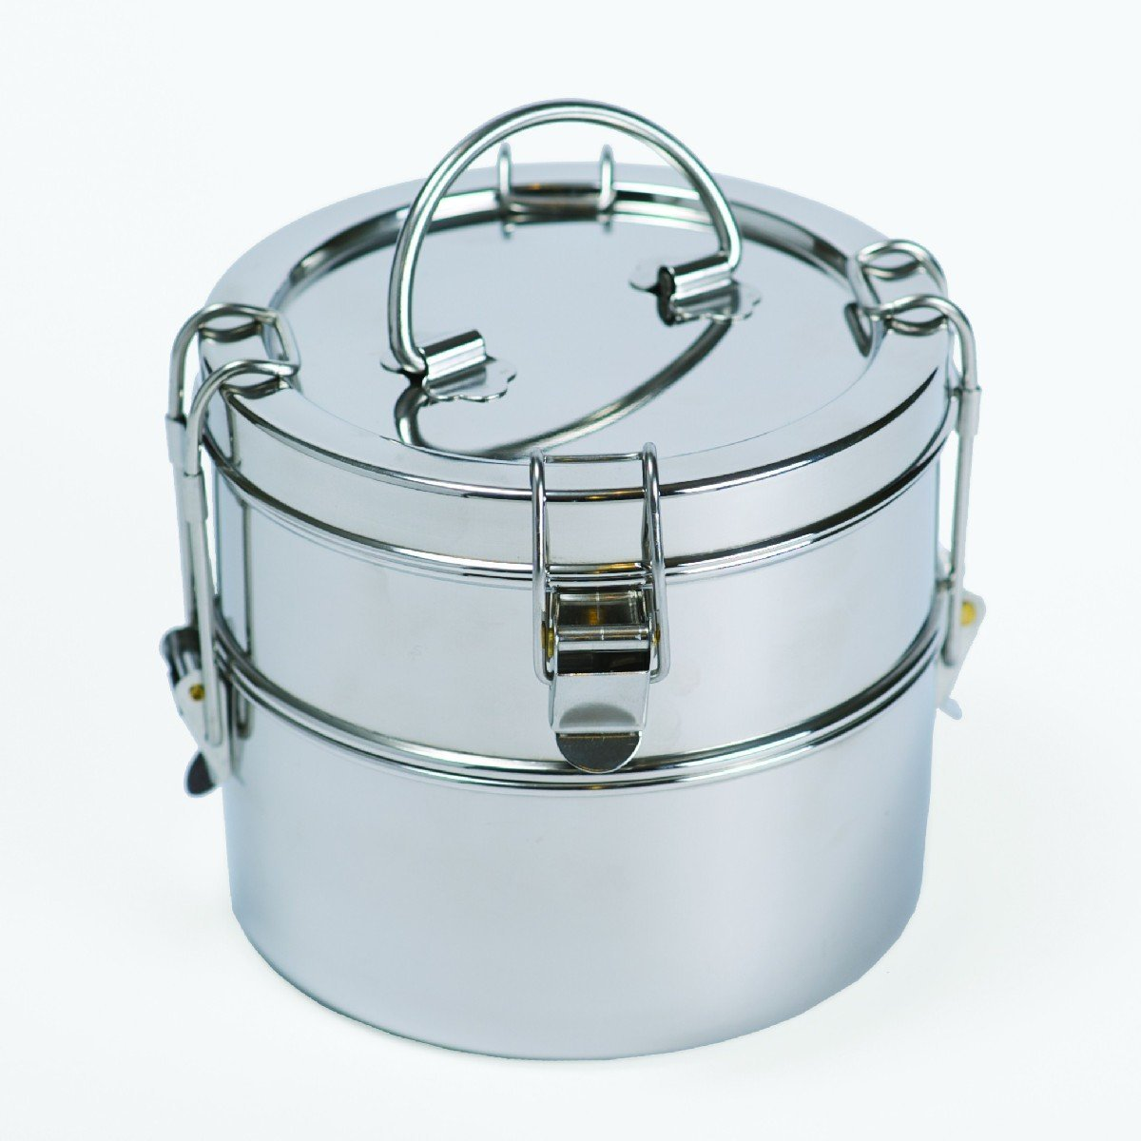
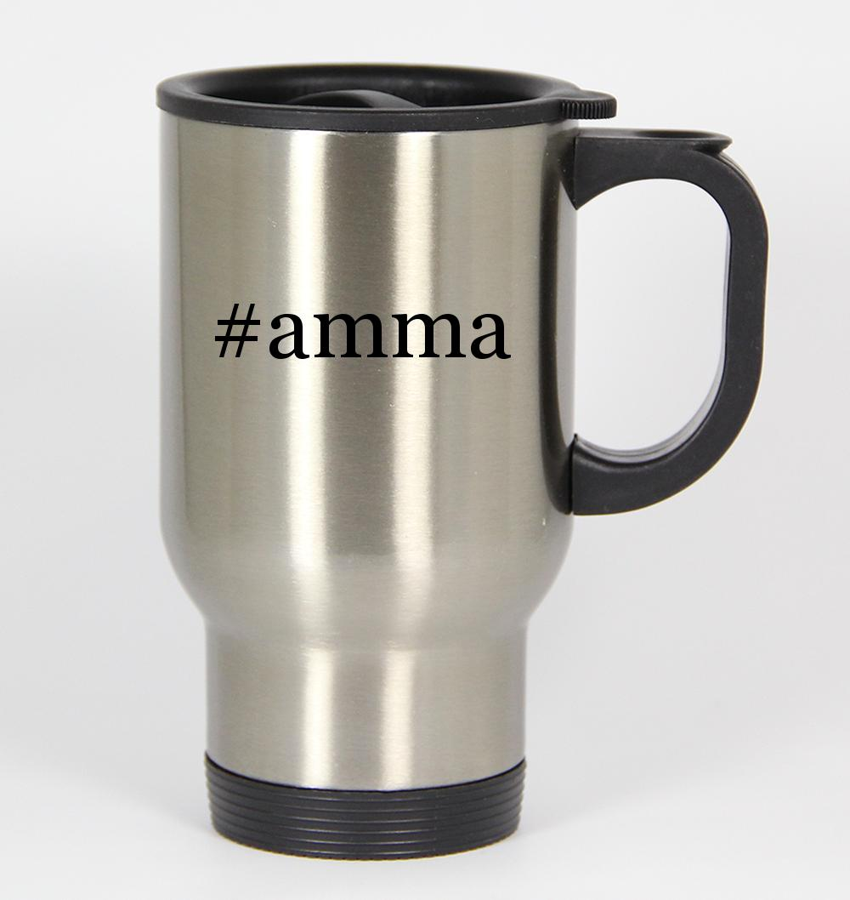
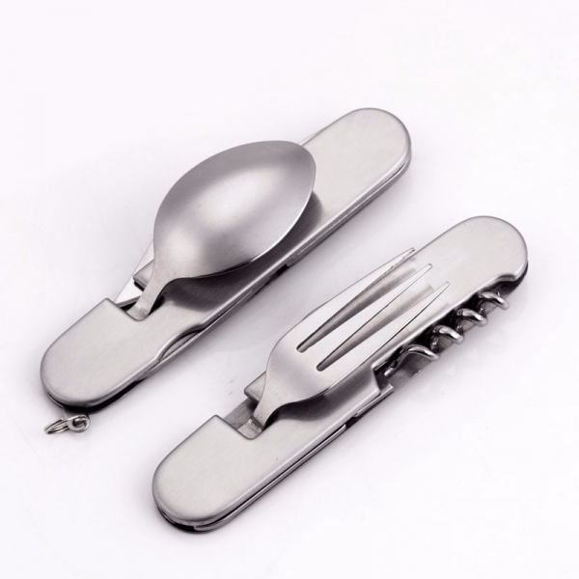
Replace Plastic:
Use reusable metal or compostable containers and cutlery

Slide 23
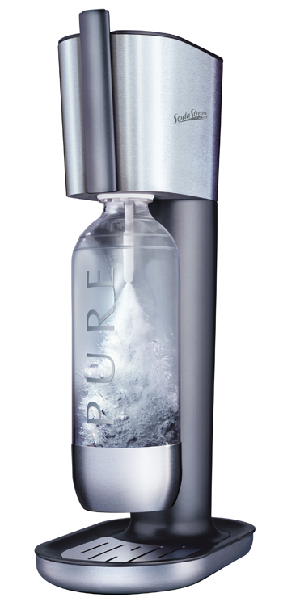
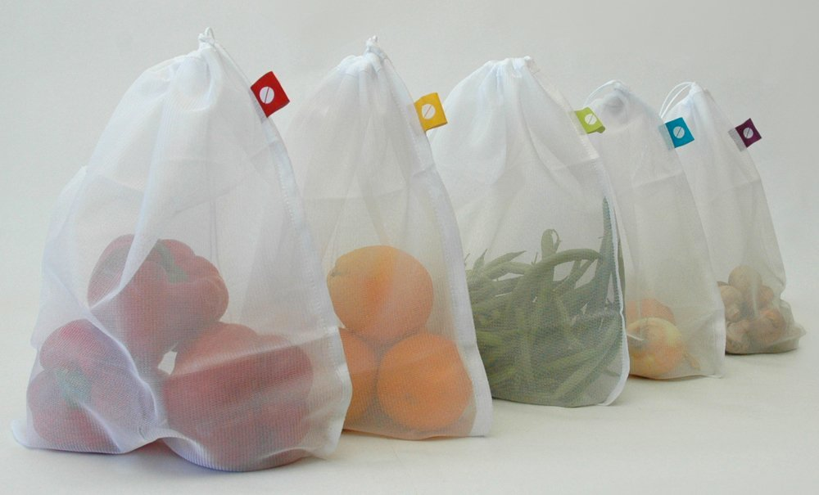
Replace Plastic:
Create your own carbonated beverages with carbonation
machines
Buy items in bulk or use cloth bags to reduce single-use
plastic packaging

Slide 24
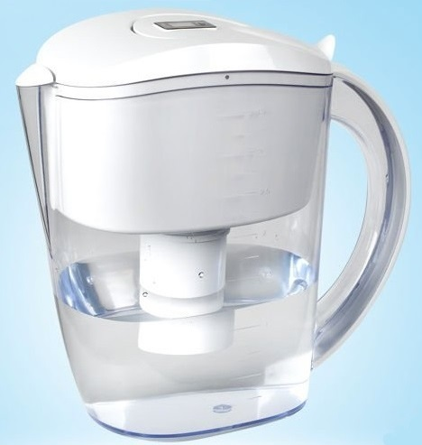
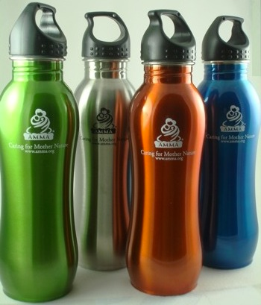
Replace Plastic:
Filter water at home
Use metal or glass bottles

Slide 25
Additional ways we can change our consumption of
Paper – Switch to electronic or sustainable alternatives
Food – Cut waste, help food rescue organizations, grow our own

Slide 26
Additional ways we can change our consumption of
Clothing - Swap, share, or buy less
Electronics - Recycle and keep longer
Natural Resources – Conserve water, electricity, and fuel

Slide 27
GreenFriends North America
WORKING TOGETHER
TOWARD
SOURCE REDUCTION

Slide 28
National Level Campaign
Educate and encourage source reduction at the local satsang level
Staff a dedicated table at Amma’s programs to promote ‘source reduction’ products and educate public
Sell ‘source reduction’ products at the Amma shop during tour and on website

Slide 29
National Level Campaign
Educational resources to be developed and
maintained at the National level:
GreenFriends North America website http://www.greenfriendsna.org/srcampaign.html
GreenFriends Facebook page
Slideshows
Fact Sheets
Videos

Slide 30
Initial activities - Winter/Spring 2018
Activity
Gather feedback from Green Friends (GF) coordinators and incorporate.
Create presentations on Plastic.
Create a communication channel for updates and feedback.
Recruit devotees interested in becoming Source Reduction coordinators or content developers.

Slide 31
Suggested Local Level Implementation- 2018/2019
Ten-minute presentations before or after satsang
Involve AYUDH in producing and delivering presentations
Satsang members pledge to take one or more steps toward source reduction
Collect pledged steps and create PowerPoints to offer Amma during her next visit to North America

Slide 32
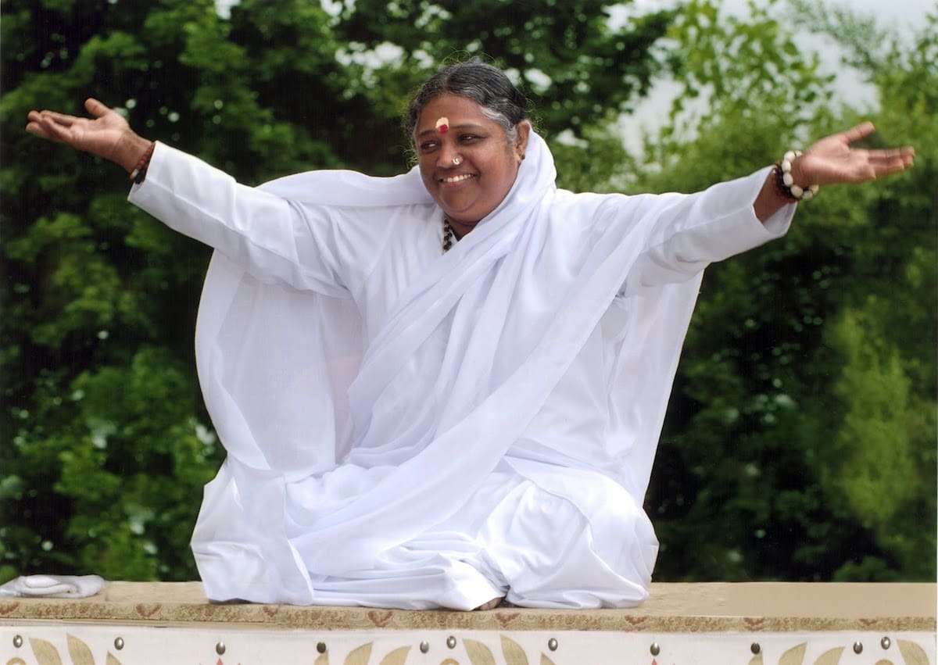
Our Most Beloved Amma,
We humbly lay this project at your Lotus Feet.
Please guide us all so that we are purer and purer instruments in Your Divine Hands.
With Love From
Your Children

Slide 33
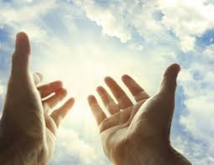
Aum Amriteswaryai Namah

